Slide 1
Metallic Fuel Microstructural Phenomena
NE 591

Slide 2
Last time
Corrosion is the environmental degradation of materials
Cladding oxidizes, forming ZrO₂
The limiting step for oxidation is the oxygen transport through the oxide layer
It begins being controlled by diffusion
Then, a protective layer forms that slows oxidation
Once transition occurs, it loses its protectiveness and speeds up again
Hydrogen released by oxidation enters the cladding
Due to low solubility (that is a function of temperature), hydrides form
Hydrides are brittle, and so reduce the ductility of the cladding

Slide 3
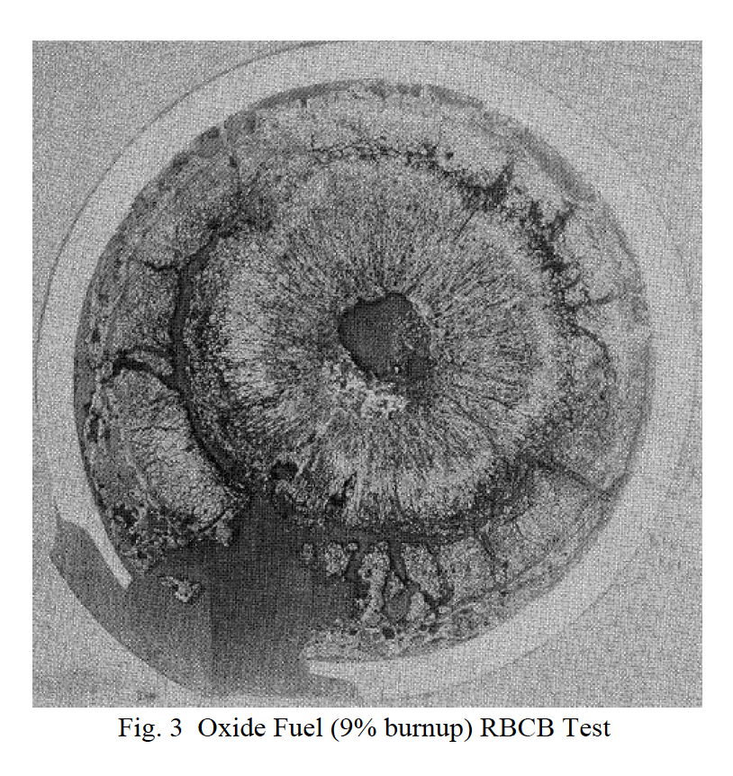
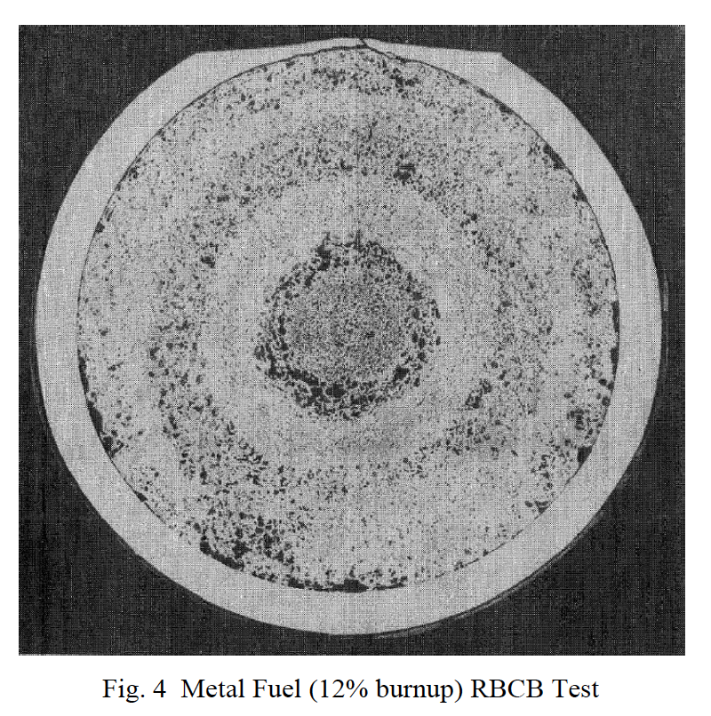
Why metallic fuel?
It has demonstrated a high burnup capability beyond 20%
Metal fuel also has superior off-normal performance characteristics, in particular for the run-beyond-cladding-breach conditions due to the compatibility of metal fuel with sodium coolant
the inherent passive safety potential where metal fuel is far superior to other fuel types
Metal fuel also allows a very simple injection-casting fabrication technique and electrorefining-based fuel cycle closure, which promises simpler waste management, proliferation-resistance, and much improved economics

Slide 4
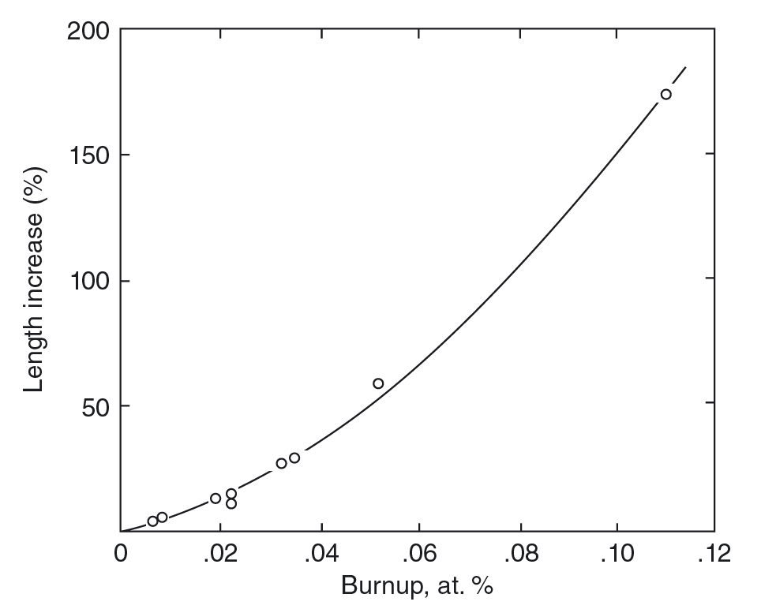
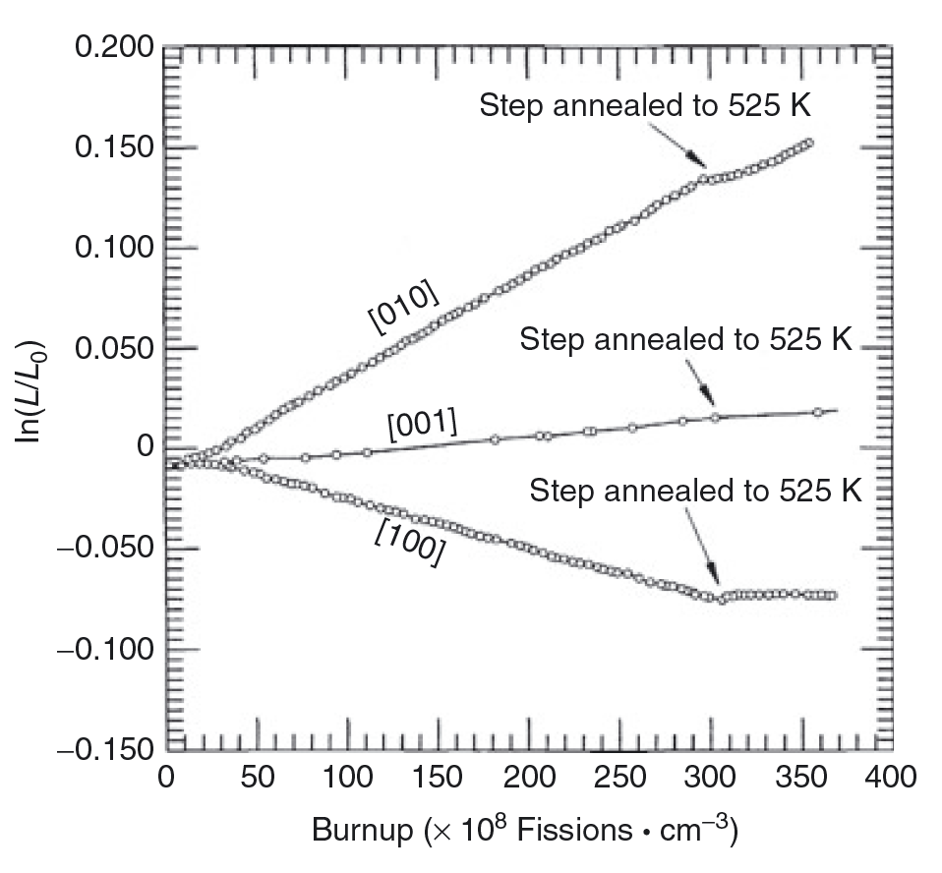
Why do we alloy?
Unalloyed swelling can reach >150% at target burnups
Anisotropic swelling of alpha U
thermal expansion
irradiation growth
Cavitation swelling is characterized by large irregular cavities that form by mechanical tearing at grain and sub-grain boundaries, resulting in a very deformed “swirled” microstructure

Slide 5
U-Zr (U-Pu-Zr)
Alloying with Zr increases melting point and stabilizes the high temperature bcc phase
Temperature range for fuel is ~800-1100 K
Typically 10 weight percent Zr (23 atomic percent)
Directly in multiphase region
find bcc, beta, alpha U, delta UZr2, alternate bcc phases

Slide 6
Fuel Redistribution

Slide 7
alpha U Tearing

Slide 8
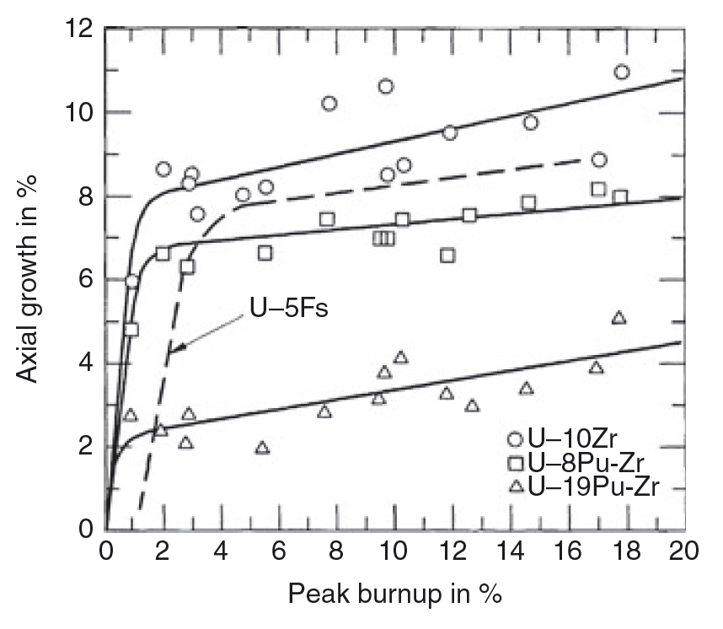
Swelling of Metallic Fuel

Slide 9
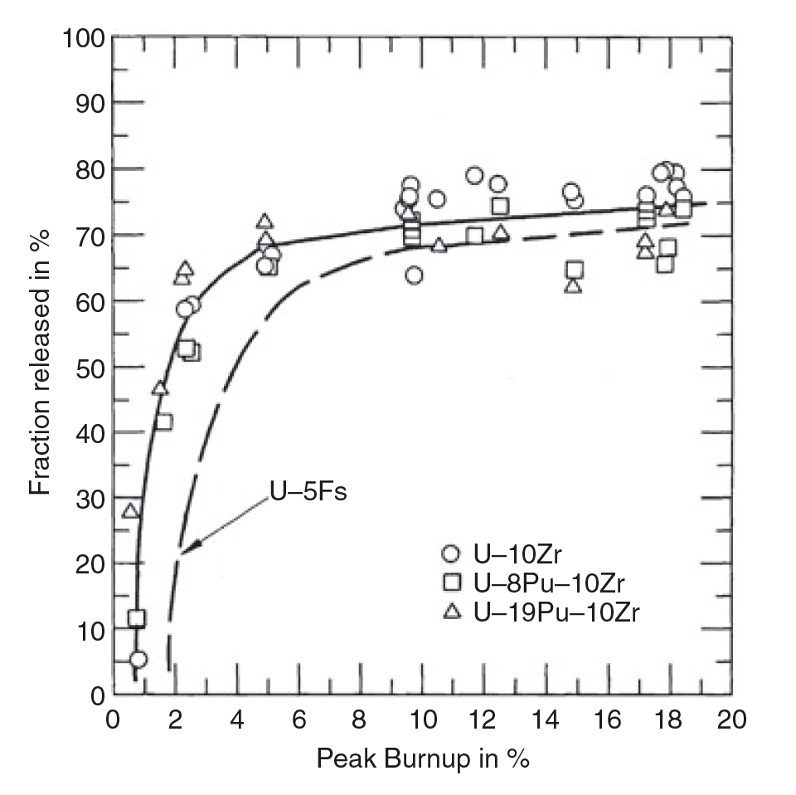
Fission Gas Release

Slide 10
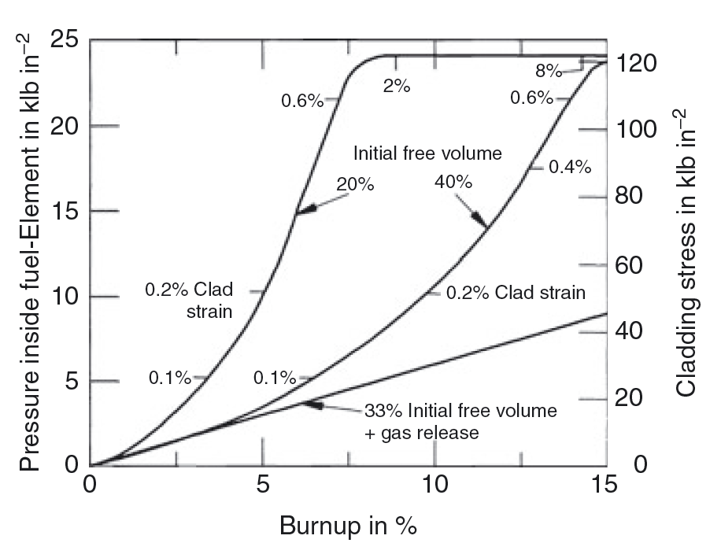
Cladding Strain

Slide 11
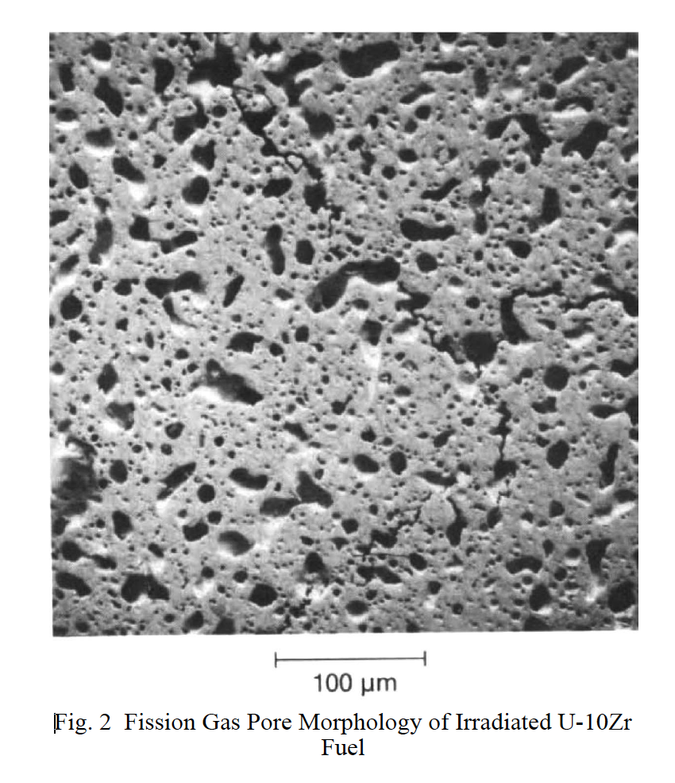
Fission Gas Bubble Morphology in gamma U

Slide 12
alpha U-Zr Bubble Morpology

Slide 13
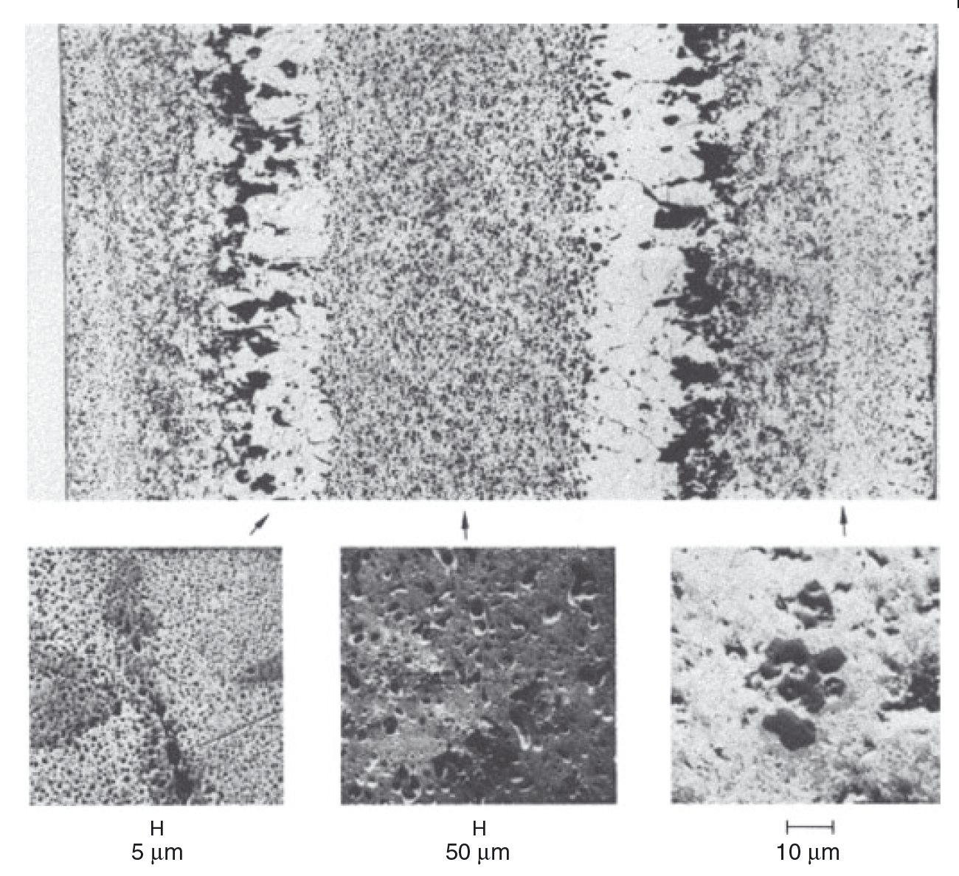
Radially Varying Bubble Morphologies

Slide 14
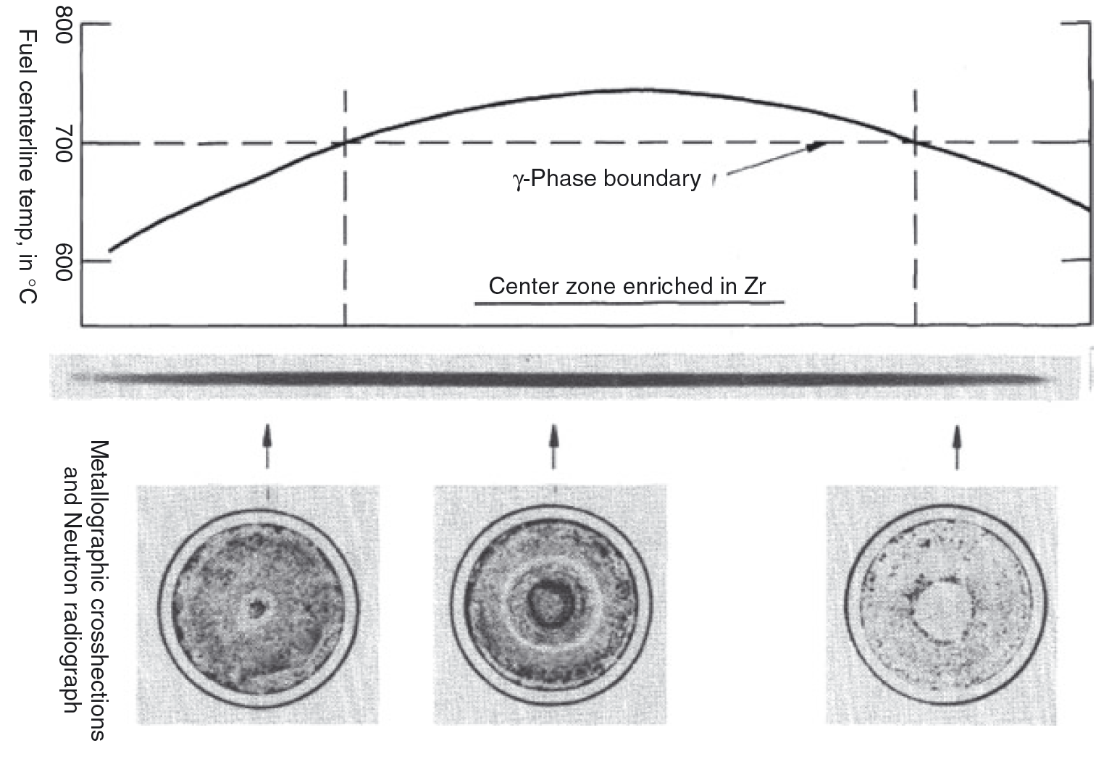
Axial Varying Microstructure

Slide 15
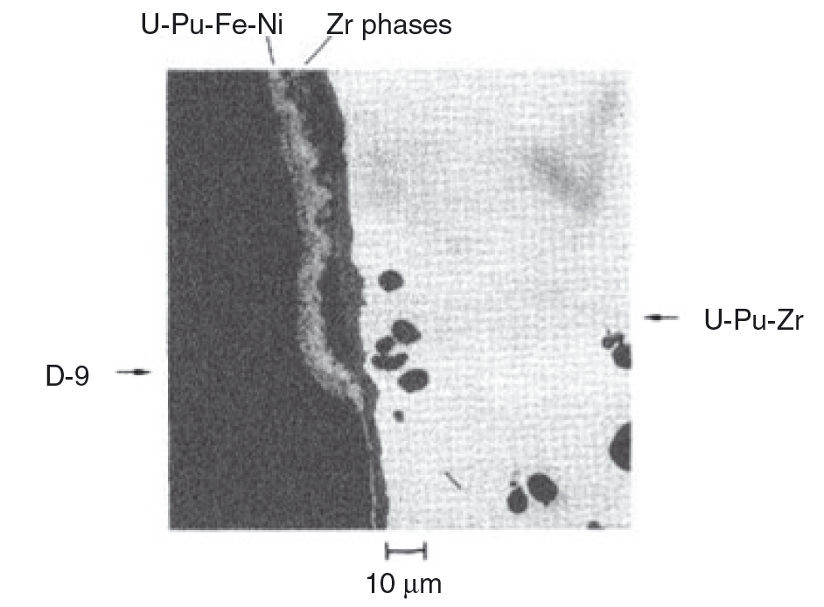
Fuel-Clad Chemical Interaction

Slide 16
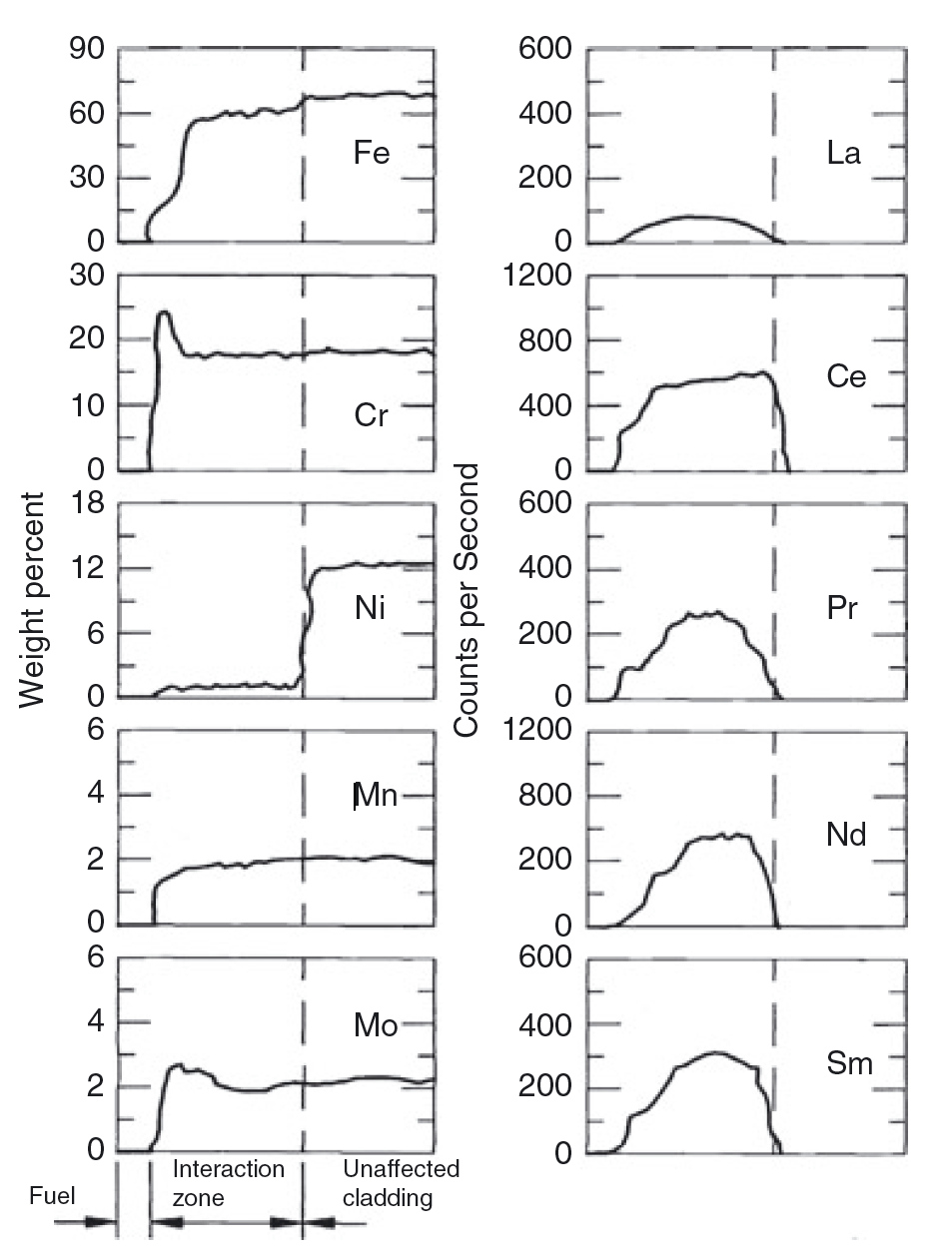
Chemical Species Interaction

